Slide 1
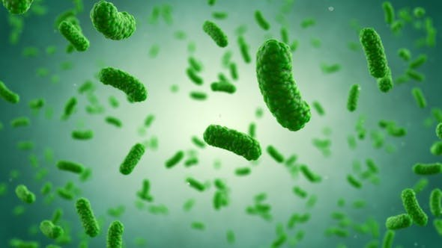
Bacteria classification problem
Presented by:
Vatsal Vador, Rohan Hulsure
Jingsheng Li

Slide 2
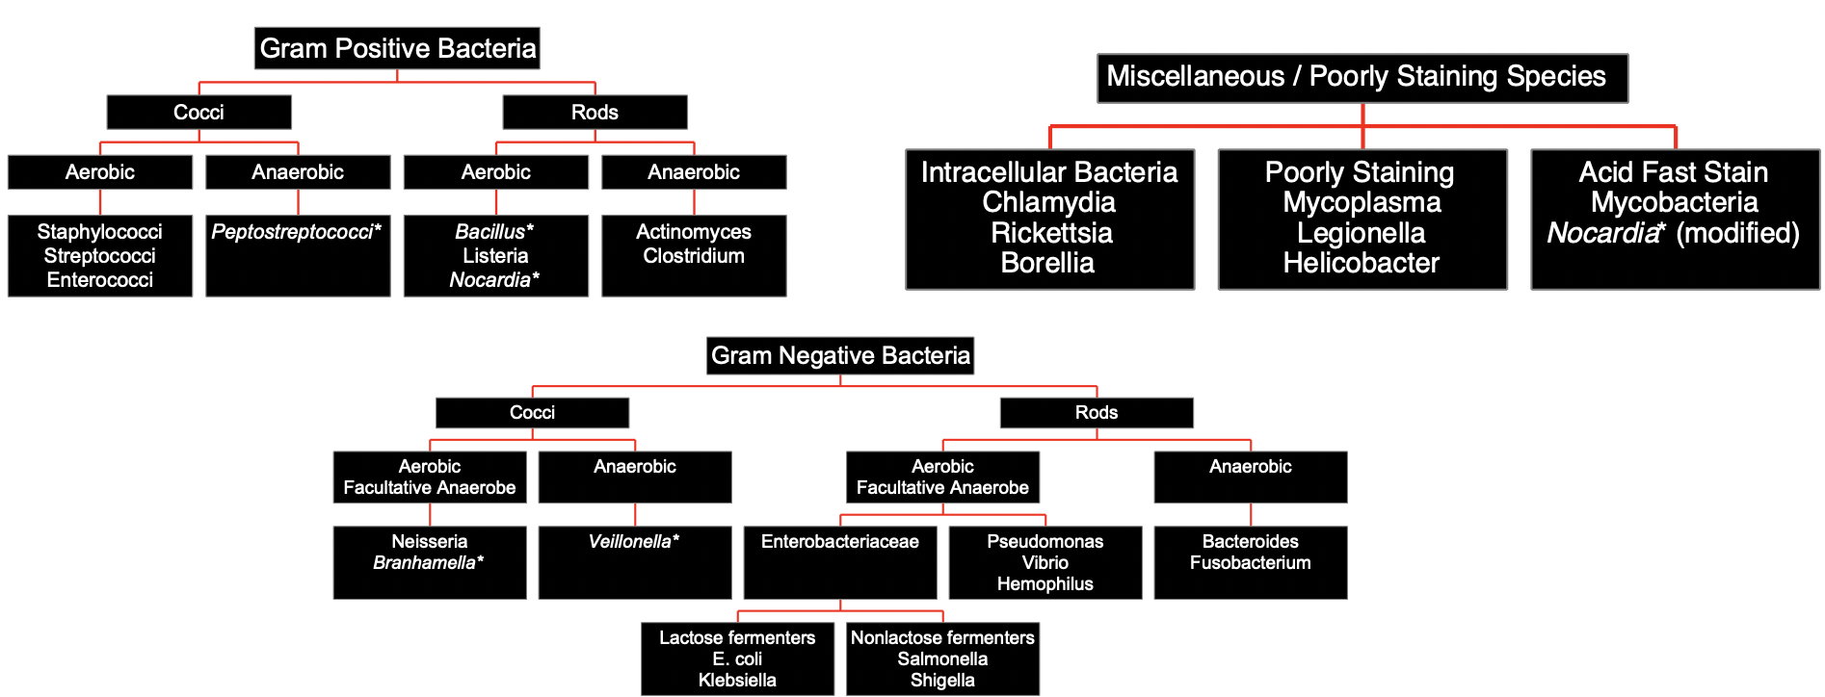
About problem

Slide 3
Team participation Rubric
Topic Research:
Rohan Hulsure, Jingsheng Li, Vatsal Vador
Preparing Dataset:
Vatsal Vador, Rohan Hulsure
Model 1:
Jingsheng Li
Model 2:
Rohan Hulsure, Vatsal Vador

Slide 4
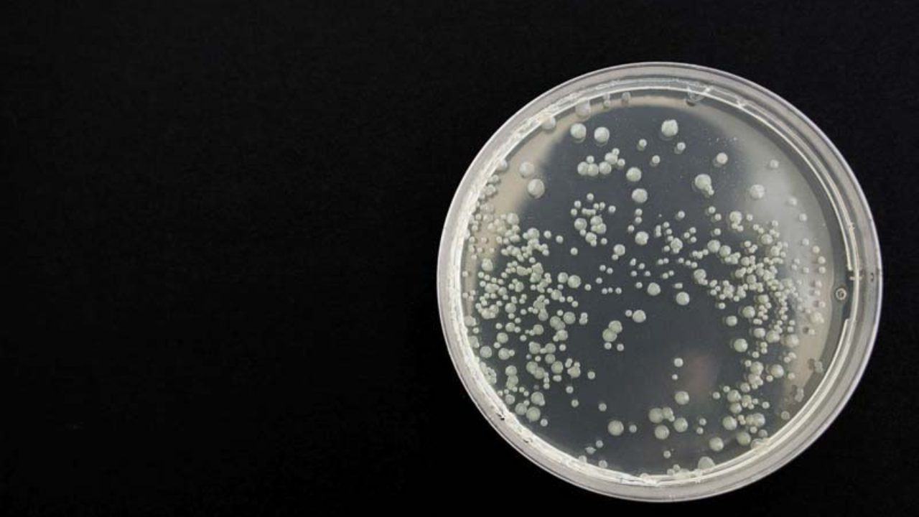
Dataset
Digital Image of Bacteria Species (DIBaS)
660 images
33 different bacteria species
Each image 9.3 mb of storage size in tiff image format
Image dimension 2048 x 1532 pixels
~ 32000 images
33 different bacteria species
Each image 80kb of storage size in png image format
Image dimension 224 x 224

Slide 5
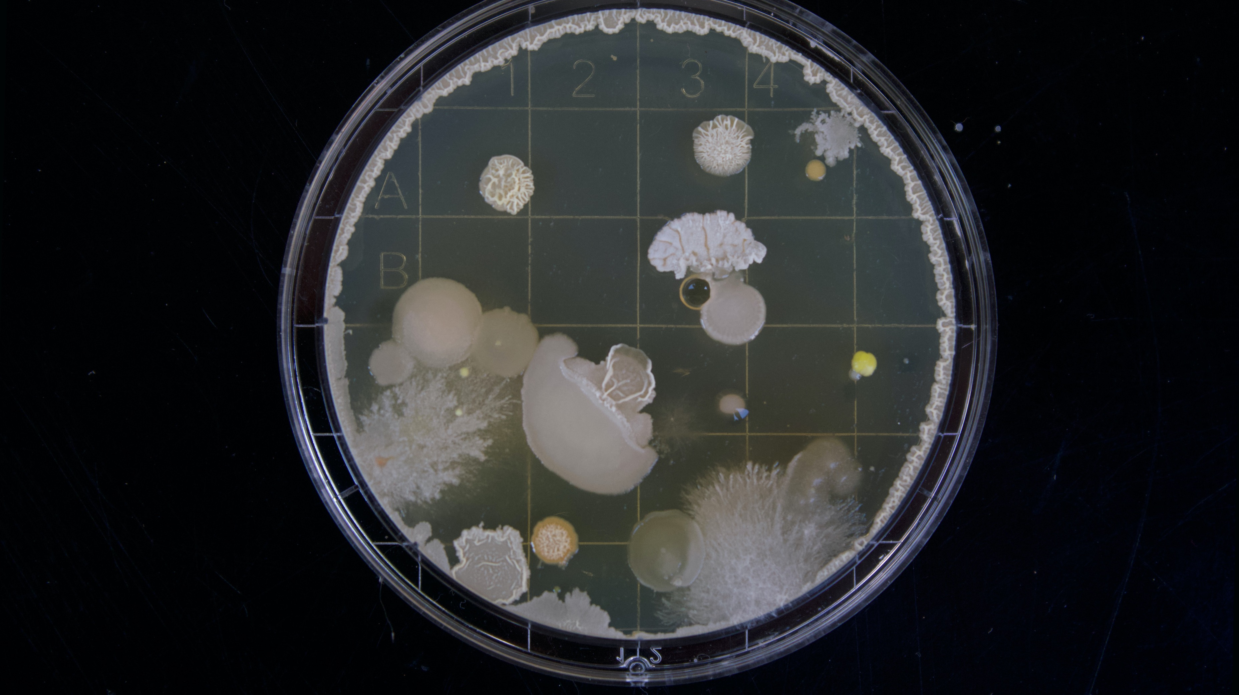
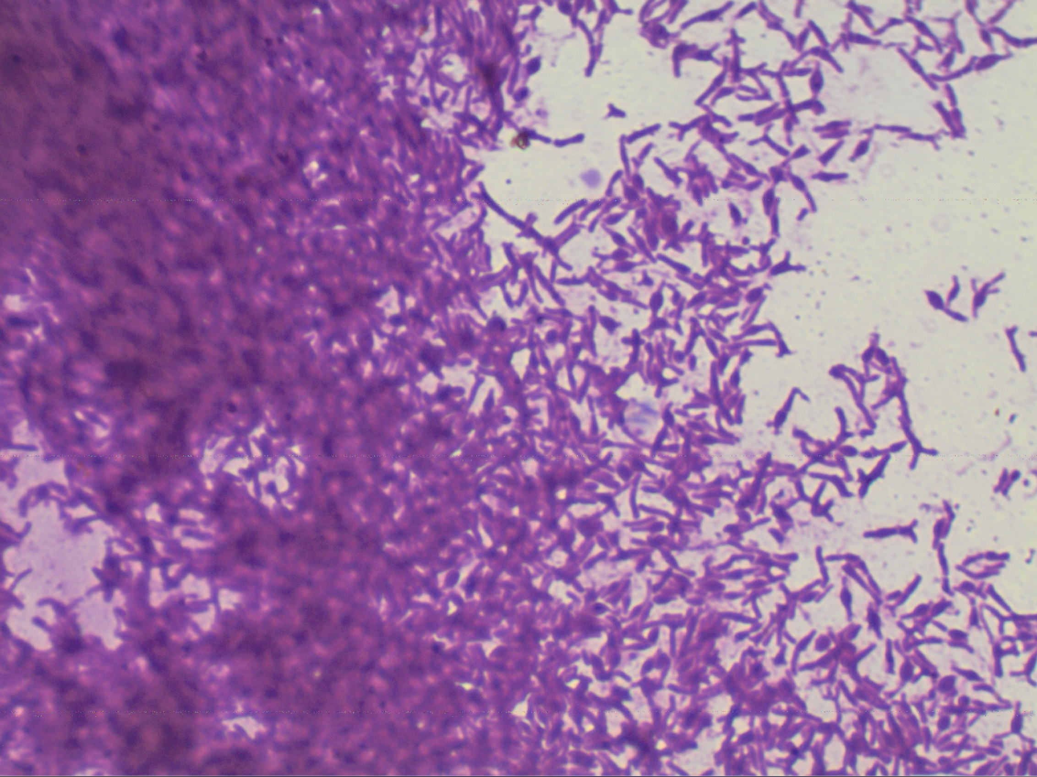
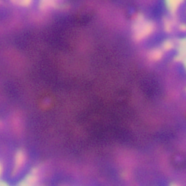
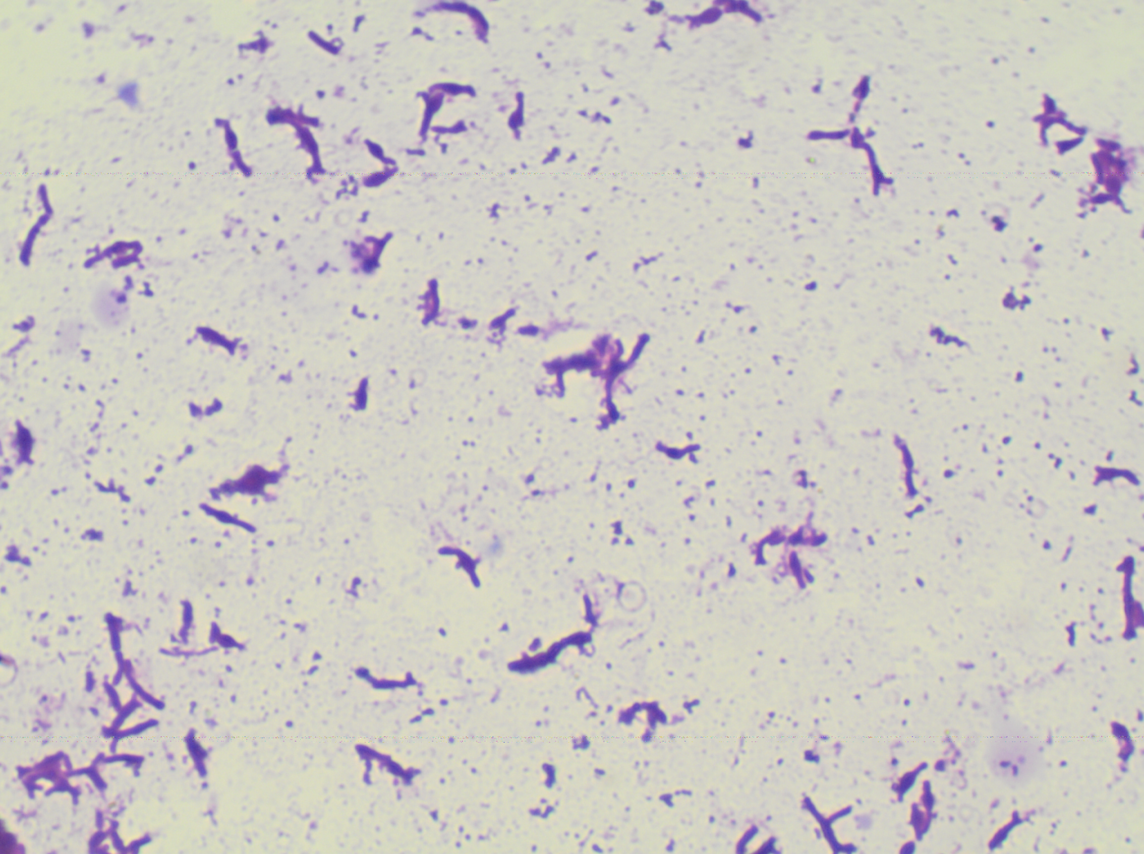
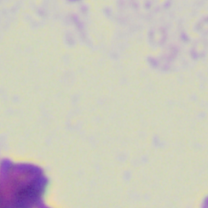
Preprocessing

Slide 6
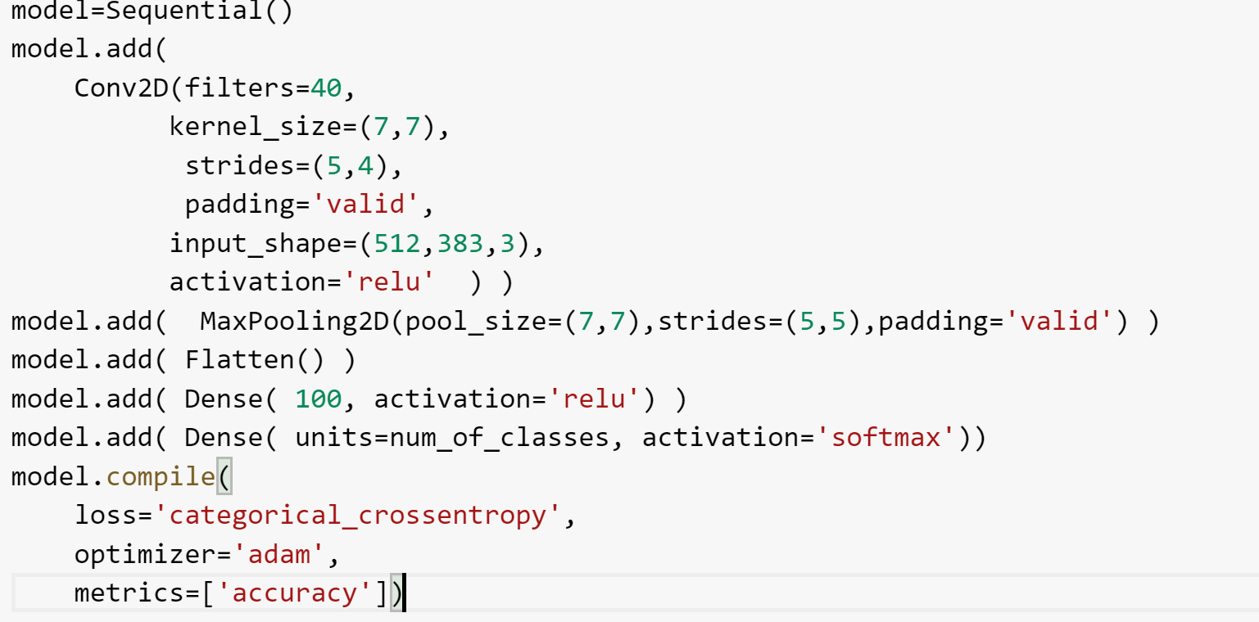
First attempt: simple, basic CNN model
Basic pre-process dataset:
image.resize((512,383))
Build Model:
Normalization
Shuffle
np_utils.to_categotical

Slide 7
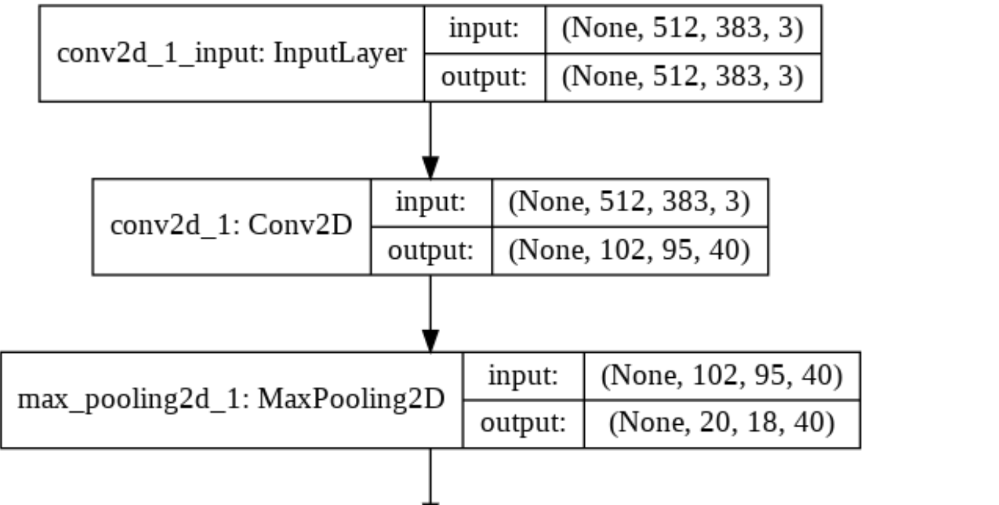
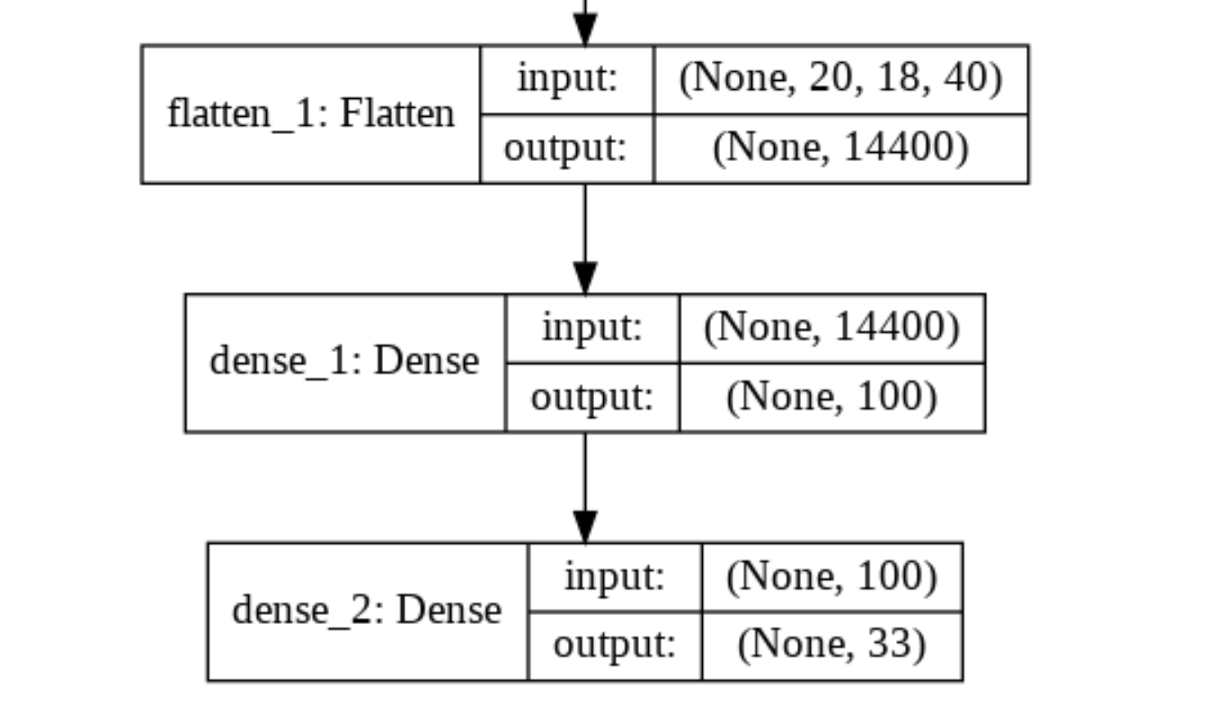
model summary

Slide 8
second attempt: with data generator
datagen=ImageDataGenerator( horizontal_flip=True )
testdatagen=ImageDataGenerator( )
history=model.fit_generator(
datagen.flow(x_train,y_train,batch_size=20,shuffle=True),
steps_per_epoch=20, epochs=30)
validation_data=(testdatagen.flow(x_test,y_test,batch_size=20,shuffle=True)), verbose=1)

Slide 9
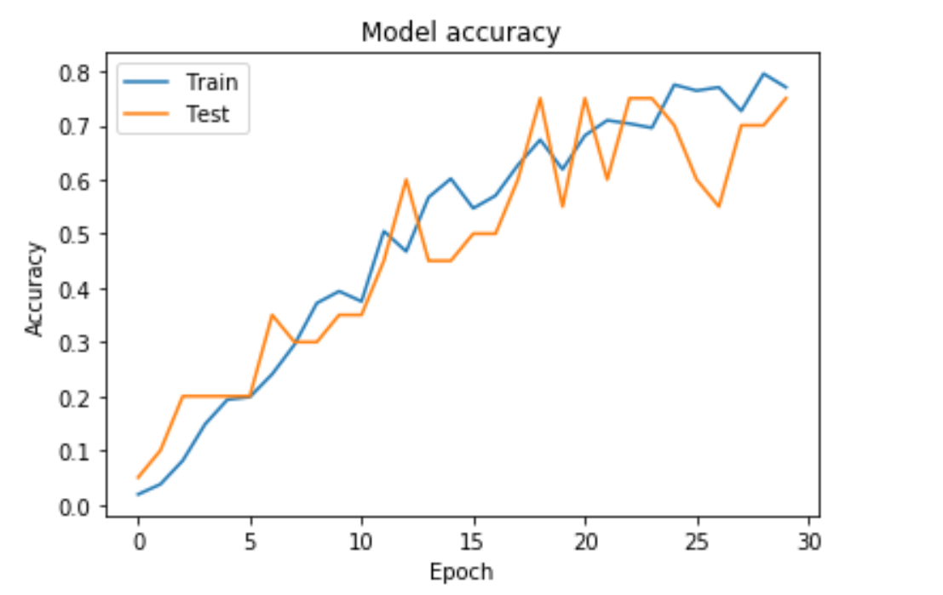
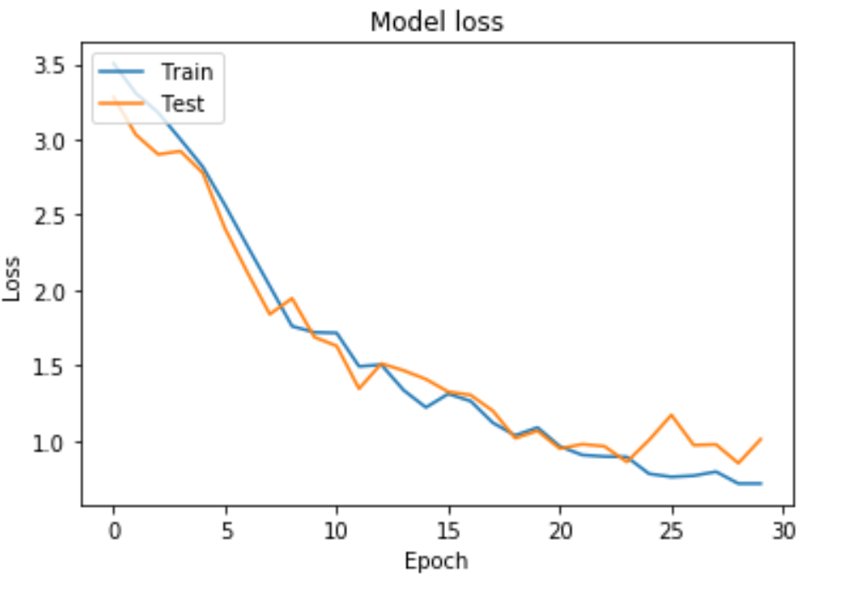
Results
Accuracy:
Loss:

Slide 10
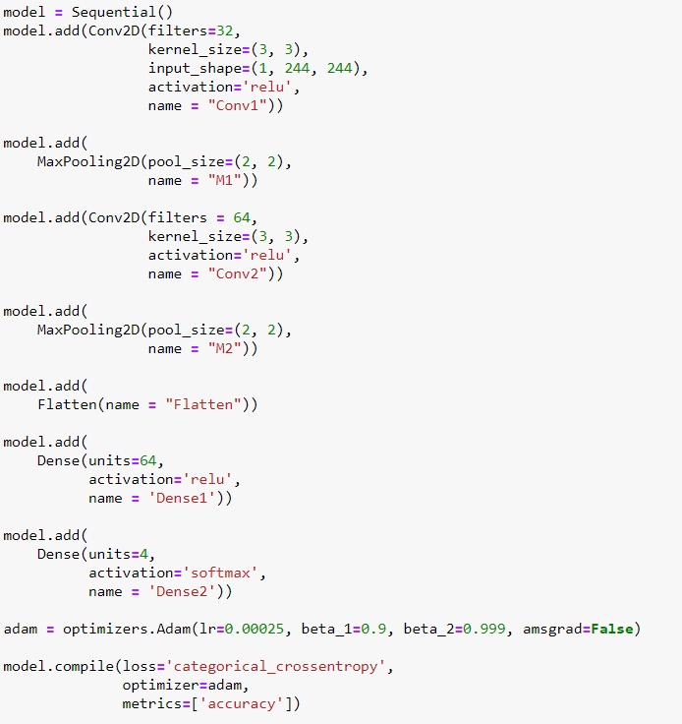
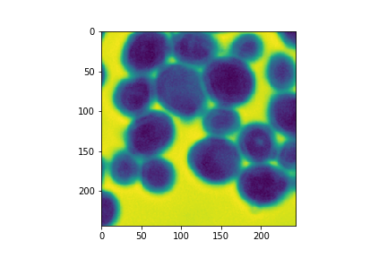
Third attempt
cvtColor(img,cv2.COLOR_BG2GRAY)

Slide 11
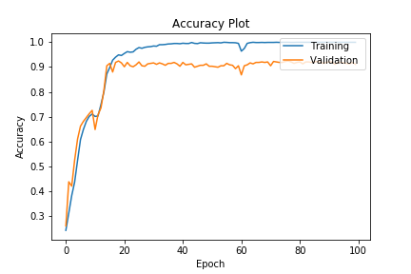
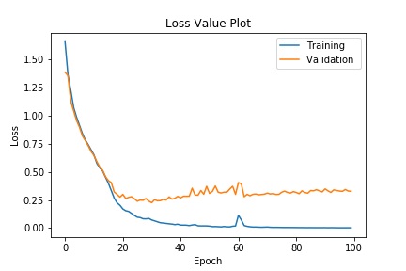
Results
Accuracy:
Loss:

Slide 12
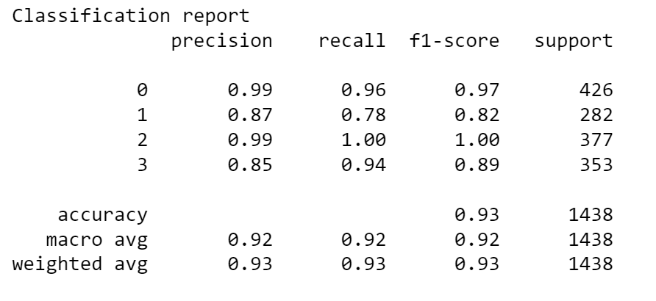
Classification report

Slide 13
Limitations & Future work
This research focuses on bacteria classification problem. Which can be extended to colonies detection
New dataset generation methods can be used to reduce culture time of colonies.
To achieve such goals using deep learning approach we can introduce image detection and localization modules

Slide 14
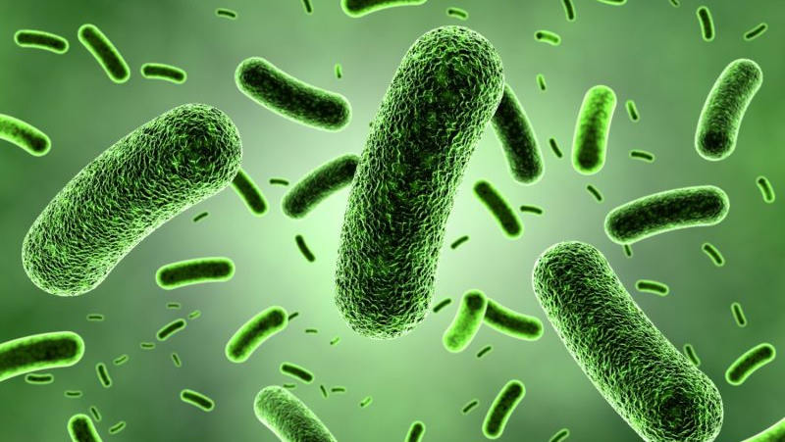
Thank YOU !! Questions ??

